Slide 1
ASIA EX-JAPAN EQUITY STRATEGY
For institutional and accredited investors only
pheim.com.sg
Confidential – Not for redistribution

Slide 2
An Early Mover
TABLE OF CONTENTS
Section 1
Section 2
Section 3
Section 4
Section 5
Section 6
Section 7
Section 8
Appendix I
Appendix II
Appendix III
Pheim Asset Management
Management & Investment Management Teams
Investment Philosophy
Investment Approach
Investment Process
Representative Fund Investment Performance
Stock Example
Summary
Board of Directors
Awards & Accolades
Pheim Malaysia
Confidential – Not for redistribution. This material must be read in conjunction with the “Disclaimer” on the last page

Slide 3
An Early Mover
1. PHEIM ASSET MANAGEMENT
Founded by Dr. Tan Chong Koay since 1994.
Pheim Asset Management comprises Pheim Asset Management Sdn Bhd (“Pheim Malaysia”), Pheim Unit Trusts Berhad (“PUTB”) and Pheim Asset Management (Asia) Pte Ltd (“Pheim Singapore”).
Pheim Singapore and Pheim Malaysia operate independently with separate investment team and client base, regulated by the Monetary Authority of Singapore (MAS) and Securities Commission of Malaysia (SC) respectively.
Pheim Singapore was established in 1995, one of the oldest boutique fund management companies in Singapore.
In 1999, Pheim Singapore was one of the first boutique fund managers to be granted the Investment Adviser Boutique Fund Manager license by the MAS.
Following which in 2002, Pheim Singapore was the first boutique fund manager in Singapore to be granted a full Investment Adviser’s license, now known as the Capital Market Services (Fund Management) license.
Source: Pheim AM.
Confidential – Not for redistribution. This material must be read in conjunction with the “Disclaimer” on the last page
3

Slide 4
An Early Mover
1. PHEIM ASSET MANAGEMENT
Ownership Structure
Pheim Asset Management (Asia) Pte Ltd – Pheim Singapore
Dr. Tan Chong Koay | 66.5%
Omar Bin Malek Ali Merican | 28.5%
Aizawa Securities Co., Ltd | 5.0%
Pheim Asset Management Sdn Bhd – Pheim Malaysia
Dr. Tan Chong Koay | 45.0%
Multi Purpose Capital Holdings Bhd | 20.0%
Omar Bin Malek Ali Merican | 15.0%
Azmi Bin Malek Merican | 15.0%
Aizawa Securities Co., Ltd | 5.0%
Source: Pheim AM.
Confidential – Not for redistribution. This material must be read in conjunction with the “Disclaimer” on the last page
4

Slide 5
An Early Mover
1. PHEIM ASSET MANAGEMENT
Total Assets under Management: USD 297.37 m*
Pheim Asset Management has deep investment experience in navigating market cycles of Asia’s equity markets. It manages on behalf of institutional investors, national pension fund and HNW clients.
Pheim Malaysia is one of the first asset management companies in Malaysia that is compliant to the Asset Manager Code of Professional Conduct of the CFA Institute.
* Includes preliminary AUM of all the companies of Pheim Asset Management which comprises of Pheim Asset Management Sdn Bhd, Pheim Unit Trusts Berhad and Pheim Asset Management (Asia) Pte Ltd. Source: Pheim AM, as at 30 June 2017.
Confidential – Not for redistribution. This material must be read in conjunction with the “Disclaimer” on the last page
5

Slide 6
1. PHEIM ASSET MANAGEMENT
ORGANISATIONAL CHART
Board of Directors
(Half of the Board Members are Independent Directors)
ARC Committee
(Audit, Risk & Compliance)
All Independent Directors
CEO - Dr. TAN
Investment
Marketing
& Business Development
Human
Resources
Operations
& Finance
Risk & Compliance
Roger ZHU
Dr. TAN
Dr. TAN
WANG Yunshan
Jasmine THAM
SZE
Jia Min
Legend
Board
Board Committee
Functions
Confidential – Not for redistribution. This material must be read in conjunction with the “Disclaimer” on the last page
6

Slide 7
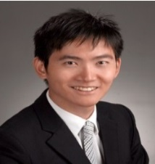
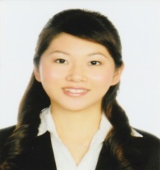
2. MANAGEMENT AND INVESTMENT MANAGEMENT TEAMS
Dr. TAN Chong Koay, Founder / Chief Strategist (41/22)
More than 40 years of investment experience
Founder of Pheim Malaysia and Pheim Singapore in 1994 and 1995 respectively
Oversees all investments and AUM growth strategy
Asset allocation
Dr. Roger ZHU, Fund Manager (6/4)
6 years of industry experience
B.Eng (Hons), Ph.D.
Country Coverage: Thailand, Indonesia, India, China/HK, Taiwan, Philippines and Australia.
Sector Coverage: Technology, Consumer, Aviation and others.
Ms. SZE Jia Min, Assistant Fund Manager (7/1)
6 years of industry experience
M.Sc. in Applied Finance
Country Coverage: Malaysia, Singapore, Korea and Vietnam.
Sector Coverage Property, REITs and Construction and Telecommunications
Numbers in brackets represent years of experience and years in firm. Source: Pheim AM, as at 1 October 2017
Confidential – Not for redistribution. This material must be read in conjunction with the “Disclaimer” on the last page
7

Slide 8
An Early Mover
3. INVESTMENT PHILOSOPHY
Investment Philosophy
Pheim practices value investing.
Pheim will fully invest near market troughs and trim exposure near market peaks, but will never fully invest at all times.
Confidential – Not for redistribution. This material must be read in conjunction with the “Disclaimer” on the last page
8

Slide 9
An Early Mover
4. INVESTMENT APPROACH
Investment Approach
Benchmark Agnostic
Bottom-up stock selection
Fundamental-driven, adopting a value approach while taking macro factors into consideration
Market capitalisation: Small- to mid-cap bias
Number of holdings: 40 to 100 stocks
Confidential – Not for redistribution. This material must be read in conjunction with the “Disclaimer” on the last page
9

Slide 10
An Early Mover
5. INVESTMENT PROCESS
1. Opportunity
Set Definition
Identify the universe of depressed or temporarily out-of-favour stocks that are backed by good fundamentals.
2. Fundamental & Technical Analysis
Prefer companies with strong balance sheet, positive earnings and attractive financial ratios.
Conduct complementary technical analysis to look out for stocks that are selling at historical lows.
3. Site Visit & Management Interview
Further due diligence is conducted via management meetings and/or company visits, and grapevine. Favour company management with integrity, capable and focused with significant interest in the companies. Transparency and corporate governance factors are also important considerations.
4. Portfolio Construction
Evaluated stock for the portfolios are proposed and discussed at the weekly Investment Committee Meetings.
Intra-week approval can be sought via circulation.
5. Ongoing
Risk Monitoring
& Management
Pre-trade compliance check.
Investment risk management is monitored by the investment team daily.
Post-trade compliance check and ongoing monitoring are carried out by designated Compliance Officer.
Confidential – Not for redistribution. This material must be read in conjunction with the “Disclaimer” on the last page
10

Slide 11
An Early Mover
6. REPRESENATIVE FUND INVESTMENT PERFORMANCE
Cumulative Net Returns – Pheim SICAV-SIF-ASEAN Emerging Companies (USD)
Returns are based on a Pheim SICAV SIF ASEAN Emerging Companies Fund managed by Pheim Malaysia and supervised by our Chief Strategist. Returns are US Dollar based and are calculated net of management fees, incentive fees, transaction costs and expenses but include reinvestment of dividends and interest. The reference benchmark is FTSE All World ASEAN Index. © Copyright FTSE Russell. Past performance is not indicative of future returns. Inception date: 3 February 1995. Source: Pheim AM, as at 30 June 2017.
Confidential – Not for redistribution. This material must be read in conjunction with the “Disclaimer” at the last page
11

Slide 12
An Early Mover
6. REPRESENATIVE FUND INVESTMENT PERFORMANCE
Annualised Net Returns – Pheim SICAV-SIF-ASEAN Emerging Companies (USD) (the “Fund”)
Periods | Fund Annualized Return | FTSE All World ASEAN Annualized Return | Excess Return | Sharpe Ratio (assuming RFR @ 1.00% pa) | Information Ratio | Fund Annualized Volatility | Annualized Tracking Error
1-Year | 8.12% | -1.36% | 9.48% | 0.64 | 1.54 | 11.18% | 6.14%
3-Year | -3.10% | -7.98% | 4.88% | -0.26 | 0.69 | 15.58% | 7.10%
5-Year | 4.63% | -2.89% | 7.52% | 0.24 | 0.98 | 15.44% | 7.63%
10-Year | 6.70% | 0.82% | 5.88% | 0.24 | 0.62 | 23.64% | 9.44%
15-Year | 12.77% | 7.09% | 5.68% | 0.56 | 0.61 | 21.15% | 9.33%
20-Year | 8.22% | 0.38% | 7.84% | 0.27 | 0.72 | 26.36% | 10.95%
Since inception (3 February 1995) | 7.89% | 0.61% | 7.28% | 0.27 | 0.68 | 25.36% | 10.70%
Returns are based on a Pheim SICAV SIF ASEAN Emerging Companies Fund. Returns are US Dollar based and are calculated net of management fees, incentive fees, transaction costs and expenses but include reinvestment of dividends and interest. The reference benchmark is FTSE All World ASEAN Index. © Copyright FTSE Russell. Past performance is not indicative of future returns. Source: Pheim AM, as at 30 June 2017.
Confidential – Not for redistribution. This material must be read in conjunction with the “Disclaimer” at the last page
12

Slide 13
An Early Mover
6. REPRESENTATIVE FUND INVESTMENT PERFORMANCE
Cumulative Net Returns – Pheim SICAV-SIF-Vittoria (USD)
Returns are based on a Pheim SICAV SIF Vittoria Fund managed by Pheim Malaysia and supervised by our Chief Strategist. Returns are US Dollar based and are calculated net of management fees, incentive fees, transaction costs and expenses but include reinvestment of dividends and interest. The reference benchmark is MSCI Far East ex Japan Index. Copyright © MSCI Inc. The benchmark return for each calendar year is the higher of 5% or 12-month US$ LIBOR + 2%, where the12-month US$ LIBOR is the rate as at the end of the preceding calendar year. Past performance is not indicative of future returns. Inception date: 1 August 2001. Source: Pheim AM, as at 30 June 2017.
Confidential – Not for redistribution. This material must be read in conjunction with the “Disclaimer” at the last page
13

Slide 14
An Early Mover
6. REPRESENATIVE FUND INVESTMENT PERFORMANCE
Annualised Net Returns – Pheim SICAV-SIF-Vittoria (USD) (the “Fund”)
Pheim SICAV-SIF-Vittoria (USD) | Fund Annualized Return | MSCI Far East ex Japan Annualized Return | Excess Return ( | Sharpe Ratio (assuming RFR @ 1.00% p.a.) | Information Ratio | Fund Annualized Volatility | Annualized Tracking Error
1-Year | 17.77% | 29.35% | -11.58% | 1.50 | -2.00 | 11.17% | 5.78%
3-Year | 0.11% | 2.75% | -2.64% | -0.05 | -0.33 | 16.55% | 7.99%
5-Year | 6.05% | 5.30% | 0.75% | 0.34 | 0.09 | 14.92% | 7.99%
10-Year | 2.64% | 1.82% | 0.82% | 0.07 | 0.07 | 22.65% | 11.60%
15-Year | 8.03% | 7.30% | 0.73% | 0.34 | 0.07 | 20.54% | 11.09%
Since inception (1 August 2001) | 9.04% | 7.62% | 1.43% | 0.39 | 0.13 | 20.52% | 11.26%
Returns are based on a Pheim SICAV SIF Vittoria Fund. Returns are US Dollar based and are calculated net of management fees, incentive fees, transaction costs and expenses but include reinvestment of dividends and interest. The reference benchmark is MSCI Far East ex Japan Index. Copyright © MSCI Inc. Past performance is not indicative of future returns. Source: Pheim AM, as at 30 June 2017.
Confidential – Not for redistribution. This material must be read in conjunction with the “Disclaimer” at the last page
14

Slide 15
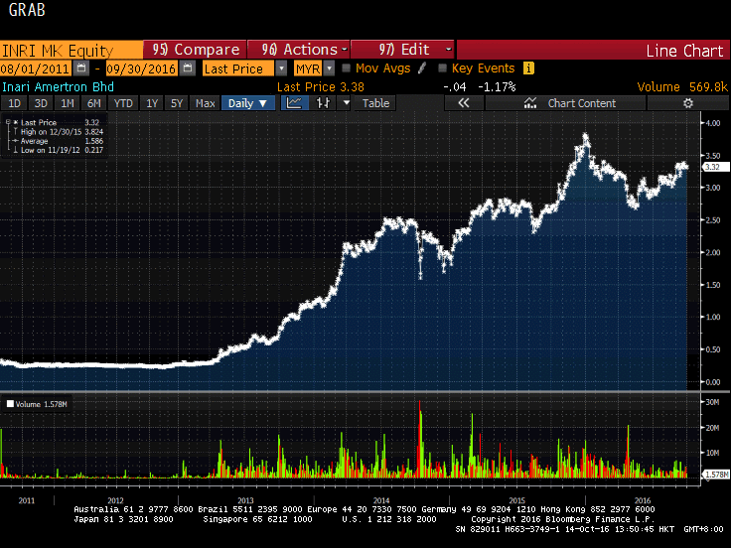
An Early Mover
7. STOCK EXAMPLE
Discovering the gems in Asia – Inari Amertron Bhd (INRI MK)
Provider of electronic manufacturing services listed on Bursa Malaysia’s ACE market on 19 July 2011 at an IPO price of RM0.38 per share.
We first looked at the stock when the share corrected in August 2013.
Bloomberg consensus showed strong growth in FY2014. We were impressed with the knowledge of the CEO, Mr KC Lau and the Executive Director, Mr. PG Ho. We opined that the company had a technical workforce that could produce at a lower cost than its peers in the growing mobile phone market.
Valuation wise, P/E was 8.3x (2013) and 5.0x (2014) at RM0.725 based a broker’s report. At RM0.82, P/E was 9.4x (2013) and 5.7x (2014) respectively.
We initiated position by end of August 2013. Our investment in the company contributed significantly to our portfolios.
Past performance is not indicative of future returns. Source: Bloomberg, as at 30 September 2016.
Confidential – Not for redistribution. This material must be read in conjunction with the “Disclaimer” at the last page
15

Slide 16
An Early Mover
8. SUMMARY
Why Pheim Asset Management?
Deep experience in Asian markets
An eye for value opportunities
Time-tested investment process which combines (1) rigorous fundamental analysis, (2) quantitative and qualitative analysis and (3) company visits and interviews to separate the chaff from the grain
High conviction investing and active management.
An Asian Equity specialist, with a focus on small- to mid-cap stocks
Fully invested at market troughs whilst not fully invested near market peaks
Confidential – Not for redistribution. This material must be read in conjunction with the “Disclaimer” on the last page
16

Slide 17
An Early Mover
APPENDIX I – THE BOARD OF DIRECTORS
The Board comprises three members, two of whom are independent:
Mr. Lim Chi Teong Independent Director
Mr. Chew Loy Cheow Independent Director
Dr. Tan Chong Koay Executive Director
The Board has a wealth of experience to guide the Company in setting its goal/direction and perform oversight.
The independent directors offer unique and diverse background coming from different segments of the industry. Together they contribute their expertise, and augment the objectivity and professionalism of the Board
Confidential – Not for redistribution. This material must be read in conjunction with the “Disclaimer” on the last page
17

Slide 18
An Early Mover
APPENDIX I – ADVISER
Mr. Teng Cheong Kwee, Adviser
Mr. Teng was previously an Executive Vice President of the Stock Exchange of Singapore (“SGX”), and later, Executive Vice President and Head, Risk Management and Regulations Division of SGX, having responsibilities for listing approval and market regulation, broker admission and supervision, investigations and risk management.
Prior to SGX, Mr. Teng spent eight (8) years with the Monetary Authority of Singapore holding positions as Assistant Director, Securities Industry Division and as Deputy Director, Domestic Division. During that period, he also served concurrently as the Secretary of the Securities Industry Council.
Mr. Teng serves as a non-executive and independent Director on the Board of several companies listed on the Singapore Exchange. He holds a Bachelor of Engineering (Industrial) (1st Class Honours) and Bachelor of Commerce from the University of Newcastle, N.S.W., Australia.
Confidential – Not for redistribution. This material must be read in conjunction with the “Disclaimer” on the last page
18

Slide 19
An Early Mover
APPENDIX I – THE BOARD OF DIRECTORS
Mr. Lim Chi Teong, Independent Director
Mr. Lim is an accountant / company secretary by training and an Associate Member of The Chartered Institute of Secretaries & Administrators. He has broad working experience in various sectors, including financial services, merchant banking, manufacturing, and trading and property development.
Mr. Lim has more than 15 years of direct investment and fund management experience starting as Investment Officer with Malaysian International Merchant Bank Bhd (Malaysia), progressing to being Deputy MD of First Siam Financial Corp Ltd (Bangkok), Portfolio Manager at Arab Malaysian Merchant Bank Bhd (Malaysia), Senior Investment Manager at DBS Asset management Ltd (Singapore) and as Director, Investment Management at Pheim Asset Management Sdn Bhd (Malaysia).
Mr. Lim holds a degree in Bachelor of Economics (Accounting) from the University of Malaya, Malaysia.
Confidential – Not for redistribution. This material must be read in conjunction with the “Disclaimer” on the last page
19

Slide 20
An Early Mover
APPENDIX I – THE BOARD OF DIRECTORS
Mr. Chew Loy Cheow, Independent Director
Mr. Chew sat on the Advisory Council of the NUS Business School’s Centre for Asset Management Research and Investment from its founding in 2008 till 2016, and is an Adjunct Associate Professor in the Finance Department. He has been appointed to the MAS-CAD Panel of Experts on Securities Offences since 2010.
Mr. Chew started his professional career in 1977. He gained expertise in dealing with various global market products, including derivatives at Wall Street institutions, Morgan Guaranty Trust Company of New York / J.P.Morgan Securities where he held senior positions including Head of FX and Fixed Income Sales (1985 – 1995) and at AIG Trading Group where he was Managing Director & Head of Singapore operations (1996 – 2003).
He was then appointed by the sovereign wealth fund Government of Singapore Investment Corporation (GIC) as a senior investment manager from 2004 – 2009. At GIC, he set up and served as Head of the Commodities and Gold Group and also helped train young management associates at GIC School.
Mr. Chew holds a Bachelor of Business Administration degree from the National University of Singapore and a Master of Arts (Contemporary China) degree from the Nanyang Technological University.
Confidential – Not for redistribution. This material must be read in conjunction with the “Disclaimer” on the last page
20

Slide 21
An Early Mover
APPENDIX I – THE BOARD OF DIRECTORS
Dr. Tan Chong Koay, Founder & Executive Director
Dr. Tan is the Founder and Chief Strategist of Pheim Asset Management (Asia) Pte Ltd (“PAM”), which was incorporated in 1995. Dr. Tan is also the Executive Chairman and Chief Strategist of Pheim Malaysia.
Dr. Tan has been working in the investment industry for the past 40 years, contributing his expertise through applying his unique and time-proven investment philosophy to clients ranging from accredited investors to unit trusts and financial institutions. He institutionalizes investment process and oversees the running of investment decisions to ensure that Pheim Singapore strictly adheres to its investment disciplines.
Pheim SICAV-SIF-ASEAN Emerging Companies Fund, launched in 1995 by Dr. Tan was ranked No. 1 on its 20th anniversary on 3rd February 2015 as it returned 497.37% (in USD terms) which far outperformed the 2nd position fund which returned 94.52% (in USD terms) and FTSE AW ASEAN CR (in USD terms) which returned 44.56%, within the Equity ASEAN of Lipper Global Classification for international offshore universe.
Dr. Tan was a member of the Investment Advisory Committee of the Lee Kwan Yew Fund and the Lee Kuan Yew Fund for Bilingualism Limited for 11 and 3 years, respectively, both ended on March 1st, 2015.
Confidential – Not for redistribution. This material must be read in conjunction with the “Disclaimer” on the last page
21

Slide 22
An Early Mover
APPENDIX II – AWARDS & ACCOLADES
Pheim Asset Management and the funds it managed won many awards and accolades over the years. Below table shows the awards and accolades won over the last 3 years:
Year | Awards & Accolades | By
2017 | Pheim SICAV-SIF - ASEAN Emerging Companies Fund was awarded the “Best of the Best Awards 2016“ for 10-Year period for the ASEAN Equity category. | Asia Asset Management
 | Dana Makmur Pheim (Balanced Islamic Fund) was ranked the Best Fund over 3-Year, 5-Year and 10-Year periods for Malaysia Islamic Funds and Best Fund over 3-Year and 5-Year periods for Malaysia Provident Funds for the Mixed Asset MYR Balanced - Malaysia category for Year 2016. Pheim was ranked the Best Group for Mixed Assets – Malaysia category for Year 2016. | The Edge / Thomson Reuters Lipper Fund Awards
2016 | Pheim Malaysia was ranked Number 1 for Best 3-Year ROI Domestic Equity Portfolio Manager for Year 2015 | Employee Provident Fund of Malaysia
 | Pheim Malaysia was awarded Best Domestic Equity Portfolio Manager for Year 2015 | Employee Provident Fund of Malaysia
 | Dana Makmur Pheim (Balanced Islamic Fund) was ranked the Best Fund for 3-Year, 5-Year and 10-Year periods for Best Mixed Asset MYR Balanced Islamic Category and Best Group in Mixed Assets Award ending December 2015 | The Edge / Thomson Reuters Lipper Fund Awards
 | Pheim SICAV-SIF - ASEAN Emerging Companies Fund was awarded "Best of the Best Performance Awards 2015" for 3-Year, 10-Year and 20-Year periods ending September 2015 for the ASEAN Equity Category. | Asia Asset Management
2015 | Pheim Emerging Companies Balanced Fund (Balanced Global Fund) was ranked the Best Fund for 3-Year and 5-Year periods for Best Mixed Asset MYR Balanced-Global Category ending December 2014 | The Edge / Thomson Reuters Lipper Fund Awards
 | Dana Makmur Pheim (Balanced Islamic Fund) was ranked the Best Fund for 3-Year and 5-Year periods for Best Mixed Asset MYR Balanced-Islamic Category ending December 2014 | The Edge / Thomson Reuters Lipper Fund Awards
 | Pheim SICAV-SIF - ASEAN Emerging Companies Fund was awarded "Best of the Best Performance Awards 2014" for 3-Year, and10-Year periods ending September 2014 for the ASEAN Equity Category. | Asia Asset Management
Past performance is not indicative of future returns. Please contact Pheim AM if you wish to have further details on the awards and accolades. Source: Pheim AM, as at 30 June 2017.
Confidential – Not for redistribution. This material must be read in conjunction with the “Disclaimer” on the last page
23

Slide 23
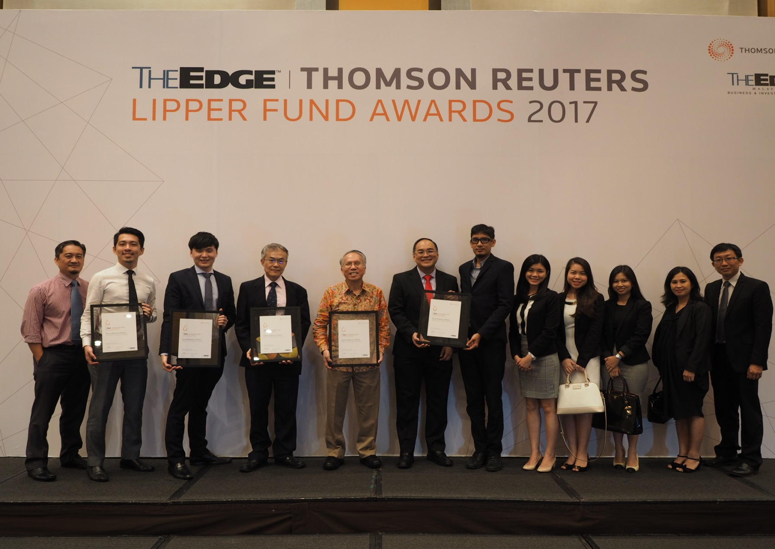
An Early Mover
APPENDIX III – PHEIM MALAYSIA
Confidential – Not for redistribution. This material must be read in conjunction with the “Disclaimer” on the last page
24

Slide 24
An Early Mover
DISCLAIMER
While the informational materials contained within this presentation are believed to be reliable and gathered from credible sources, there is no warranty or guarantee of the accuracy of the information provided by the company and its group affiliates, employees or directors. The material provided is for information purposes only and of itself does not constitute nor should be construed as an offer to sell or any solicitation or any offer of invitation to purchase or subscribe for interests or securities in Singapore or any other jurisdiction, nor should it or any part of it form the basis of, or be relied upon in any connection with any, contract or commitment whatsoever.
The information is intended for institutional and accredited investors and the recipient should be aware of the securities laws and regulation of your jurisdiction in your review of the material. The material should not be construed as formal investment, legal, tax or accounting advice and such formal advice should be acquired by any individual investor prior to making an investment.
The strategies, instruments and/or opinions in that regard contained within the material may not be suitable or appropriate for all investors. The material does not account for the individual investor’s risk requirements, needs, circumstances and objectives. Past performance is not indicative or a warranty of future results.
The funds presented are not managed by Pheim Singapore. They are managed by Pheim Malaysia and supervised by our Chief Strategist. They have not been approved for sale in Singapore. The information provided is not intended for, nor shall it be considered as, marketing of Pheim Malaysia products/services.
Pheim Singapore expressly disclaims any liability, including incidental or consequential damages arising from errors or omissions in this publication. The value of interests or securities in the Funds and the income derived from them may fall as well as rise. The interests or securities in the Funds are not obligations of, deposits in, or guaranteed by Pheim Singapore or any of its group affiliates. All investment products, including without limitation to derivatives products, are subject to investment risks, including possible loss to principal investments held.
This presentation may contain forward-looking statements that involve risks and uncertainties. Actual future performance, outcomes and results may differ materially from those expressed in forward-looking statements as a result of a number of risks, uncertainties and assumptions. Representative examples of these factors include (without limitation) general industry and economic conditions, interest rate trends, cost of capital and capital availability, competition from similar developments, shifts in expected levels of property rental income and occupancy, changes in operating expenses, including employee wages, benefits and training, property expense and governmental and public policy changes and the continued availability reliance on these forward-looking statements, which are based on Pheim Singapore’s current view of future events.
This presentation has been prepared by Pheim Singapore. The information in this presentation has not been independently verified. No representation, warranty, express or implied, is made as to, and no reliance should be placed on, the fairness, accuracy, completeness or correctness of the information and opinions in this presentation. Neither Pheim Singapore nor any of its agents or advisers, nor any of their respective affiliates, advisers or representatives, shall have any liability (in negligence or otherwise) for any loss howsoever arising from any use of this presentation or its contents or otherwise arising in connection with this presentation.
Neither this presentation, nor any copy or portion of it, may be sent, taken, transmitted or distributed, directly or indirectly, in or into the United States, Japan or Canada, or to any U.S. person (as such term is defined in Regulation S under the Securities Act of 1933, as amended). It is not an offer of securities for sale into the United States. The interests or securities in the Funds may not be offered or sold into the United States, Canada or Japan or to, or for the account or benefit of, U.S. persons unless they are registered or exempt from registration. The interests or securities in the Fund have not been and will not be registered under the Securities Act or the securities laws of any state of the United States. There will be no public offer of securities in the United States.
Asia ex Japan Eq_28082017_SG

